Slide 1
Finite
Automata and Formal Languages(18CS52)
DEPARTMENT OF CSE
R V College of Engineering

Slide 2
Introduction to Automata Theory
Unit 1

Slide 3
What is Automata Theory?
Study of abstract computing devices, or “machines”
Automaton = an abstract computing device
Note: A “device” need not even be a physical hardware!
A fundamental question in computer science:
Find out what different models of machines can do and cannot do
The theory of computation
Computability vs. Complexity

Slide 4
Alphabet
An alphabet is a finite, non-empty set of symbols
We use the symbol ∑ (sigma) to denote an alphabet
Examples:
Binary: ∑ = {0,1}
All lower case letters: ∑ = {a,b,c,..z}
Alphanumeric: ∑ = {a-z, A-Z, 0-9}
Digits:∑ = { 0-9}

Slide 5
Strings
A string or word is a finite sequence of symbols chosen from ∑
Empty string is ε (or “epsilon”)
Length of a string w, denoted by “|w|”, is equal to the number of (non- ε) characters in the string
E.g., x = 010100 |x| = 6
x = 01 ε 0 ε 1 ε 00 ε |x| = ?
xy = concatentation of two strings x and y

Slide 6
Powers of an alphabet
Let ∑ be an alphabet.
∑^{k} = the set of all strings of length k
∑* = ∑⁰ U ∑¹ U ∑² U …
∑⁺ = ∑¹ U ∑² U ∑³ U …

Slide 7
Languages
L is a said to be a language over alphabet ∑, only if L ⊆ ∑*
🡺 this is because ∑* is the set of all strings (of all possible length including 0) over the given alphabet ∑
Examples:
Let L be the language of all strings consisting of n 0’s followed by n 1’s: L = {ε, 01, 0011, 000111,…}
Let L be the language of all strings of with equal number of 0’s and 1’s:
L = {ε, 01, 10, 0011, 1100, 0101, 1010, 1001,…}
Definition: Ø denotes the Empty language
Let L = {ε}; Is L=Ø?
NO

Slide 8
Finite Automata-Applications
Software for designing and checking the behavior of digital circuits
Lexical analyzer of a typical compiler
Software for scanning large bodies of text (e.g., web pages) for pattern finding
Software for verifying systems of all types that have a finite number of states (e.g., stock market transaction, communication/network protocol)

Slide 9
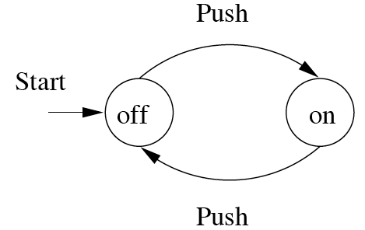
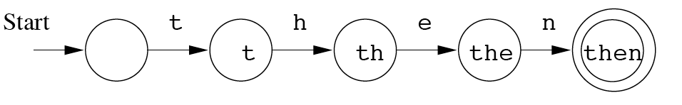
Finite Automata : Examples
action
On/Off switch
Model to recognize word “then”
state
Start state
Transition
Intermediate state
Final state

Slide 10
Finite Automaton (FA)
A state diagram that comprehensively captures all possible states and transitions that a machine can take while responding to a stream or sequence of input symbols
Recognizer for “Regular Languages”
Deterministic Finite Automata (DFA)
The machine can exist in only one state at any given time
Non-deterministic Finite Automata (NFA)
The machine can exist in multiple states at the same time

Slide 11
Deterministic Finite Automata - Definition
A Deterministic Finite Automaton (DFA) consists of:
Q ==> a finite set of states
∑ ==> a finite set of input symbols (alphabet)
q₀ ==> a start state
F ==> set of accepting states
δ ==> a transition function, which is a mapping between Q x ∑ ==> Q
A DFA is defined by the 5-tuple:
{Q, ∑ , q₀,F, δ }

Slide 12
What does a DFA do on reading an input string?
Input: a word w in ∑*
Question: Is w acceptable by the DFA?
Steps:
Start at the “start state” q₀
For every input symbol in the sequence w do
Compute the next state from the current state, given the current input symbol in w and the transition function
If after all symbols in w are consumed, the current state is one of the accepting states (F) then accept w;
Otherwise, reject w.

Slide 13
Regular Languages
Let L(A) be a language recognized by a DFA A.
Then L(A) is called a “Regular Language”.
Recursively- enumerable (TM)
Context- sensitive (LBA)
Context- free
(PDA)
Regular
(DFA)
A hierarchy of classes of formal languages
‹#›

Slide 14
Example #1
Build a DFA for the following language:
L = {w | w is a binary string that contains 01 as a substring}
Steps for building a DFA to recognize L:
∑ = {0,1}
Decide on the states: Q
Designate start state and final state(s)
δ: Decide on the transitions:
“Final” states == same as “accepting states”
Other states == same as “non-accepting states”

Slide 15
DFA for strings containing 01
Regular expression: (0+1)*01(0+1)*
What makes this DFA deterministic?
Q = {q₀,q₁,q₂}
∑ = {0,1}
start state = q₀
F = {q₂}
Transition table
1
0
0,1
start
0
1
q₀
q₁
q₂
Accepting
state
symbols
0
1
q₀
q₁
q₀
What if the language allows empty strings?
q₁
q₁
q₂
states
*q₂
q₂
q₂

Slide 16
Example #2
Build a DFA for the following language: L = { w | where leftmost symbol differs from rightmost symbol, ∑ ={a,b}}

Slide 17
Example #3
Build a DFA for the following language: L = { Except containing substring aab, ∑ ={a , b} }

Slide 18
Example #4
Build a DFA for the following language: L = {W: |W| mod 5 !=0, W €(0,1)}

Slide 19
Example #5
Build a DFA for the following language: L={ab³Wb² : W € {a,b}*}

Slide 20
Example #6
Build a DFA for the following language: L = {aWa | ∑ ={a , b} }

Slide 21
Extension of transitions (δ) to Paths (δ)
δ (q,w) = destination state from state q on input string w
δ (q,wa) = δ (δ(q,w), a)

Slide 22
Extension of transitions (δ) to Paths (δ)
δ (q,w) = destination state from state q on input string w
δ (q,wa) = δ (δ(q,w), a)

Slide 23
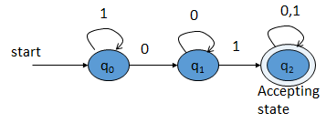
Extension of transitions (δ) to Paths (δ)
using the input sequence w=10101
δ (q0, ε) =q0
δ (q0, 1) =δ (δ (q0, ε) ,1)= δ (q0,1)=q0
δ (q0, 10) =δ (δ (q0, 1) ,0)= δ (q0,0)=q1
δ (q0, 101) =δ (δ (q0, 10) ,1)= δ (q1,1)=q2
δ (q0, 1010) =δ (δ (q0, 101) ,0)= δ (q2,1)=q2
δ (q0, 10101) =δ (δ (q0, 1010) ,1)= δ (q2,1)=q2

Slide 24
Extension of transitions (δ) to Paths (δ)
using the input sequence w=1001

Slide 25
Extension of transitions (δ) to Paths (δ)
using the input sequence w=1001
δ (q0, ε) =q0
δ (q0, 1) =δ (δ (q0, ε) ,1)= δ (q0,1)=q0
δ (q0, 10) =δ (δ (q0, 1) ,0)= δ (q0,0)=q1
δ (q0, 100) =δ (δ (q0, 10) ,0)= δ (q1,0)=q1
δ (q0, 1001) =δ (δ (q0, 100) ,1)= δ (q1,1)=q2

Slide 26
Language of a DFA -Definition
A DFA A accepts string w if there is a path from q₀ to an accepting (or final) state that is labeled by w
i.e., L(A) = { w | δ(q₀,w) ∈ F }
I.e., L(A) = all strings that lead to an accepting state from q₀

Slide 27
Non-deterministic Finite Automata (NFA)
A Non-deterministic Finite Automaton (NFA)
is of course “non-deterministic”
Implying that the machine can exist in more than one state at the same time
Transitions could be non-deterministic
1
q_{j}
q_{i}
…
Each transition function therefore maps to a set of states
1
q_{k}

Slide 28
Non-deterministic Finite Automata (NFA)
A Non-deterministic Finite Automaton (NFA) consists of:
Q ==> a finite set of states
∑ ==> a finite set of input symbols (alphabet)
q₀ ==> a start state
F ==> set of accepting states
δ ==> a transition function, which is a mapping between Q x ∑ ==> subset of Q ( 2^{Q} )
An NFA is also defined by the 5-tuple:
{Q, ∑ , q₀,F, δ }

Slide 29
How to use an NFA?
Input: a word w in ∑*
Question: Is w acceptable by the NFA?
Steps:
Start at the “start state” q₀
For every input symbol in the sequence w do
Determine all possible next states from all current states, given the current input symbol in w and the transition function
If after all symbols in w are consumed and if at least one of the current states is a final state then accept w;
Otherwise, reject w.

Slide 30
NFA for strings containing 01
Regular expression: (0+1)*01(0+1)*
Why is this non-deterministic?
Q = {q₀,q₁,q₂}
Σ = {0,1}
start state = q₀
F = {q₂}
Transition table
0,1
0,1
start
0
1
q₀
q₁
q₂
Final
state
symbols
0
1
What will happen if at state q₁ an input of 0 is received?
q₀
{q₀,q₁}
{q₀}
states
q₁
Φ
{q₂}
*q₂
{q₂}
{q₂}

Slide 31
Example #2
Build an NFA for the following language: L = { w | w ends in 01}

Slide 32
Example #3
Build an NFA for the following language: L = {aWa | ∑ ={a , b} }

Slide 33
Example #4
Build an NFA for the following language: L={ab³Wb² : W € {a,b}*}

Slide 34
Example #5
Build an NFA for the following language: L = { w | where leftmost symbol differs from rightmost symbol, ∑ ={a,b}}

Slide 35
Example #6
Build an NFA for the following language: L = { w | w is abab^{n} or aba^{n} |n>=0}

Slide 36
Extension of δ to NFA Paths
Basis: δ (q,ε) = {q}
Induction:
Let δ (q₀,w) = {p₁,p₂…,p_{k}}
δ (p_{i},a) = S_{i} for i=1,2...,k
Then, δ (q₀,wa) = S₁ U S₂ U … U S_{k}

Slide 37
Language of an NFA
An NFA accepts w if there exists at least one path from the start state to an accepting (or final) state that is labeled by w
L(N) = { w | δ(q₀,w) ∩ F ≠ Φ }

Slide 38
Advantages & Caveats for NFA
Great for modeling regular expressions
String processing - e.g., grep, lexical analyzer
Could a non-deterministic state machine be implemented in practice?
Probabilistic models could be viewed as extensions of non-deterministic state machines (e.g., toss of a coin, a roll of dice)
They are not the same though
A parallel computer could exist in multiple “states” at the same time

Slide 39
Differences: DFA vs. NFA
But, DFAs and NFAs are equivalent in their power to capture langauges !!
DFA
All transitions are deterministic
Each transition leads to exactly one state
For each state, transition on all possible symbols (alphabet) should be defined
Accepts input if the last state visited is in F
Sometimes harder to construct because of the number of states
Practical implementation is feasible
NFA
Some transitions could be non-deterministic
A transition could lead to a subset of states
Not all symbol transitions need to be defined explicitly (if undefined will go to an error state – this is just a design convenience, not to be confused with “non-determinism”)
Accepts input if one of the last states is in F
Generally easier than a DFA to construct
Practical implementations limited but emerging (e.g., Micron automata processor)

Slide 40
Equivalence of DFA & NFA
Theorem:
A language L is accepted by a DFA if and only if it is accepted by an NFA.
Proof:
If part:
Prove by showing every NFA can be converted to an equivalent DFA (in the next few slides…)
Only-if part is trivial:
Every DFA is a special case of an NFA where each state has exactly one transition for every input symbol. Therefore, if L is accepted by a DFA, it is accepted by a corresponding NFA.
Should be true for any L

Slide 41
Proof for the if-part
If-part: A language L is accepted by a DFA if it is accepted by an NFA
rephrasing…
Given any NFA N, we can construct a DFA D such that L(N)=L(D)
How to convert an NFA into a DFA?
Observation: In an NFA, each transition maps to a subset of states
Idea: Represent:
each “subset of NFA_states” 🡺 a single “DFA_state”
Subset construction

Slide 42
NFA to DFA by subset construction
Let N = {Q_{N},∑,δ_{N},q₀,F_{N}}
Goal: Build D={Q_{D},∑,δ_{D},{q₀},F_{D}} s.t. L(D)=L(N)
Construction:
Q_{D}= all subsets of Q_{N} (i.e., power set)
F_{D}=set of subsets S of Q_{N} s.t. S∩F_{N}≠Φ
δ_{D}: for each subset S of Q_{N} and for each input symbol a in ∑:
δ_{D}(S,a) = U δ_{N}(p,a)
p in s

Slide 43
NFA to DFA construction: Example
Idea: To avoid enumerating all of power set, do “lazy creation of states”
L = {w | w ends in 01}
1
0
NFA:
DFA:
[q₀]
0
[q₀,q₁]
1
[q₀,q₂]
0,1
0
0
1
1
q₀
q₁
q₂
δ_{D} | 0 | 1
Ø | Ø | Ø
[q₀] | {q₀,q₁} | {q₀}
[q₁] | Ø | {q₂}
*[q₂] | Ø | Ø
[q₀,q₁] | {q₀,q₁} | {q₀,q₂}
*[q₀,q₂] | {q₀,q₁} | {q₀}
*[q₁,q₂] | Ø | {q₂}
*[q₀,q₁,q₂] | {q₀,q₁} | {q₀,q₂}
δ_{D} | 0 | 1
[q₀] | [q₀,q₁] | [q₀]
[q₀,q₁] | [q₀,q₁] | [q₀,q₂]
*[q₀,q₂] | [q₀,q₁] | [q₀]
δ_{N} | 0 | 1
q₀ | {q₀,q₁} | {q₀}
q₁ | Ø | {q₂}
*q₂ | Ø | Ø
0. Enumerate all possible subsets
Determine transitions
2. Retain only those states reachable from {q₀}

Slide 44
NFA to DFA: Repeating the example using LAZY CREATION
L = {w | w ends in 01}
1
0
NFA:
DFA:
[q₀]
0
[q₀,q₁]
1
[q₀,q₂]
0,1
0
0
1
1
q₀
q₁
q₂
δ_{N} | 0 | 1
q₀ | {q₀,q₁} | {q₀}
q₁ | Ø | {q₂}
*q₂ | Ø | Ø
δ_{D} | 0 | 1
[q₀] | [q₀,q₁] | [q₀]
[q₀,q₁] | [q₀,q₁] | [q₀,q₂]
*[q₀,q₂] | [q₀,q₁] | [q₀]
Main Idea:
Introduce states as you go
(on a need basis)

Slide 45
Correctness of subset construction
Theorem: If D is the DFA constructed from NFA N by subset construction, then L(D)=L(N)
Proof:
Show that δ_{D}({q₀},w) ≡ δ_{N}(q₀,w} , for all w
Using induction on w’s length:
Let w = xa
δ_{D}({q₀},xa) ≡ δ_{D}( δ_{N}(q₀,x}, a ) ≡ δ_{N}(q₀,w}

Slide 46
A bad case where #states(DFA)>>#states(NFA)
L = {w | w is a binary string s.t., the k^{th} symbol from its end is a 1}
NFA has k+1 states
But an equivalent DFA needs to have at least 2^{k} states
(Pigeon hole principle)
m holes and >m pigeons
=> at least one hole has to contain two or more pigeons

Slide 47
Applications
Text indexing
inverted indexing
For each unique word in the database, store all locations that contain it using an NFA or a DFA
Find pattern P in text T
Example: Google querying
Extensions of this idea:
PATRICIA tree, suffix tree

Slide 48
A few subtle properties of DFAs and NFAs
The machine never really terminates.
It is always waiting for the next input symbol or making transitions.
The machine decides when to consume the next symbol from the input and when to ignore it.
(but the machine can never skip a symbol)
=> A transition can happen even without really consuming an input symbol (think of consuming ε as a free token) – if this happens, then it becomes an ε-NFA (see next few slides).
A single transition cannot consume more than one (non-ε) symbol.

Slide 49
FA with ε-Transitions
We can allow explicit ε-transitions in finite automata
i.e., a transition from one state to another state without consuming any additional input symbol
Explicit ε-transitions between different states introduce non-determinism.
Makes it easier sometimes to construct NFAs
Definition: ε -NFAs are those NFAs with at least one explicit ε-transition defined.
ε -NFAs have one more column in their transition table

Slide 50
Example of an ε-NFA
L = {w | w is empty, or if non-empty will end in 01}
0,1
ε-closure of a state q, ECLOSE(q), is the set of all states (including itself) that can be reached from q by repeatedly making an arbitrary number of ε-transitions.
q₀
0
q₁
1
q₂
ε
start
q’₀
δ_{E} | 0 | 1 | ε
*q’₀ | Ø | Ø | {q’₀,q₀}
q₀ | {q₀,q₁} | {q₀} | {q₀}
q₁ | Ø | {q₂} | {q₁}
*q₂ | Ø | Ø | {q₂}
ECLOSE(q’₀)
ECLOSE(q₀)
ECLOSE(q₁)
ECLOSE(q₂)

Slide 51
Example of an ε-NFA
To simulate any transition: Step 1) Go to all immediate destination states.
Step 2) From there go to all their ε-closure states as well.
L = {w | w is empty, or if non-empty will end in 01}
0,1
Simulate for w=101:
q₀
0
q₁
1
q₂
ε
q₀’
start
ε
ε
q’₀
q₀’
q₀
1
1
δ_{E} | 0 | 1 | ε
*q’₀ | Ø | Ø | {q’₀,q₀}
q₀ | {q₀,q₁} | {q₀} | {q₀}
q₁ | Ø | {q₂} | {q₁}
*q₂ | Ø | Ø | {q₂}
Ø
q₀
x
0
ECLOSE(q’₀)
q₁
ECLOSE(q₀)
1
q₂

Slide 52
Example of another ε-NFA
To simulate any transition: Step 1) Go to all immediate destination states.
Step 2) From there go to all their ε-closure states as well.
0,1
Simulate for w=101:
?
q₀
0
q₁
1
q₂
ε
ε
1
start
q’₀
q₃
δ_{E} | 0 | 1 | ε
*q’₀ | Ø | Ø | {q’₀,q₀,q₃}
q₀ | {q₀,q₁} | {q₀} | {q_{0,}q₃}
q₁ | Ø | {q₂} | {q₁}
*q₂ | Ø | Ø | {q₂}
q₃ | Ø | {q₂} | {q₃}

Slide 53
Equivalency of DFA, NFA, ε-NFA
Theorem: A language L is accepted by some ε-NFA if and only if L is accepted by some DFA
Implication:
DFA ≡ NFA ≡ ε-NFA
(all accept Regular Languages)

Slide 54
Eliminating ε-transitions
Let E = {Q_{E},∑,δ_{E},q₀,F_{E}} be an ε-NFA
Goal: To build DFA D={Q_{D},∑,δ_{D},{q_{D}},F_{D}} s.t. L(D)=L(E)
Construction:
Q_{D}= all reachable subsets of Q_{E} factoring in ε-closures
q_{D} = ECLOSE(q₀)
F_{D}=subsets S in Q_{D} s.t. S∩F_{E}≠Φ
δ_{D}: for each subset S of Q_{E} and for each input symbol a∈∑:
Let R= U δ_{E}(p,a) // go to destination states
δ_{D}(S,a) = U ECLOSE(r) // from there, take a union of all their ε-closures
p in s
r in R

Slide 55
Example: ε-NFA 🡺 DFA
L = {w | w is empty, or if non-empty will end in 01}
0,1
q₀
0
q₁
1
q₂
ε
start
q’₀
δ_{E} | 0 | 1 | ε
*q’₀ | Ø | Ø | {q’₀,q₀}
q₀ | {q₀,q₁} | {q₀} | {q₀}
q₁ | Ø | {q₂} | {q₁}
*q₂ | Ø | Ø | {q₂}
δ_{D} | 0 | 1
*{q’₀,q₀}
…

Slide 56
Example: ε-NFA 🡺 DFA
L = {w | w is empty, or if non-empty will end in 01}
0,1
0
{q₀,q₁}
0
0
1
{q₀,q₂}
q₀
q₁
q₂
0
1
ε
0
{q’₀, q₀}
1
start
start
1
q’₀
q₀
1
ECLOSE
union
δ_{E} | 0 | 1 | ε
*q’₀ | Ø | Ø | {q’₀,q₀}
q₀ | {q₀,q₁} | {q₀} | {q₀}
q₁ | Ø | {q₂} | {q₁}
*q₂ | Ø | Ø | {q₂}
δ_{D} | 0 | 1
*{q’₀,q₀} | {q₀,q₁} | {q₀}
{q₀,q₁} | {q₀,q₁} | {q₀,q₂}
{q₀} | {q₀,q₁} | {q₀}
*{q₀,q₂} | {q₀,q₁} | {q₀}

Slide 57
Equivalence & Minimization of DFAs

Slide 58
Applications of interest
Comparing two DFAs:
L(DFA₁) == L(DFA₂)?
How to minimize a DFA?
Remove unreachable states
Identify & condense equivalent states into one

Slide 59
When to call two states in a DFA “equivalent”?
Two states p and q are said to be equivalent iff:
Any string w accepted by starting at p is also accepted by starting at q;
Any string w rejected by starting at p is also rejected by starting at q.
p
w
q
AND
p
w
q
🡺 p≡q

Slide 60
Computing equivalent states in a DFA
Table Filling Algorithm
A | =
B | = | =
C | x | x | =
D | x | x | x | =
E | x | x | x | x | =
F | x | x | x | x | x | =
G | x | x | x | = | x | x | =
H | x | x | = | x | x | x | x | =
 | A | B | C | D | E | F | G | H
0
1
A
0
C
1
E
0
G
1
0
1
0
1
B
1
D
1
F
0
H
1
0
0
Pass #0
Mark accepting states ≠ non-accepting states
Pass #1
Compare every pair of states
Distinguish by one symbol transition
Mark = or ≠ or blank(tbd)
Pass #2
Compare every pair of states
Distinguish by up to two symbol transitions (until different or same or tbd)
….
(keep repeating until table complete)

Slide 61
Table Filling Algorithm - step by step
A | =
B |  | =
C |  |  | =
D |  |  |  | =
E |  |  |  |  | =
F |  |  |  |  |  | =
G |  |  |  |  |  |  | =
H |  |  |  |  |  |  |  | =
 | A | B | C | D | E | F | G | H
0
1
A
0
C
1
E
0
G
1
0
1
0
1
B
1
D
1
F
0
H
1
0
0

Slide 62
Table Filling Algorithm - step by step
A | =
B |  | =
C |  |  | =
D |  |  |  | =
E | X | X | X | X | =
F |  |  |  |  | X | =
G |  |  |  |  | X |  | =
H |  |  |  |  | X |  |  | =
 | A | B | C | D | E | F | G | H
0
1
A
0
C
1
E
0
G
1
0
1
0
1
B
1
D
1
F
0
H
1
0
0
Mark X between accepting vs. non-accepting state

Slide 63
Table Filling Algorithm - step by step
A | =
B |  | =
C | X |  | =
D | X |  |  | =
E | X | X | X | X | =
F |  |  |  |  | X | =
G | X |  |  |  | X |  | =
H | X |  |  |  | X |  |  | =
 | A | B | C | D | E | F | G | H
0
1
A
0
C
1
E
0
G
1
0
1
0
1
B
1
D
1
F
0
H
1
0
0
Mark X between accepting vs. non-accepting state
Look 1- hop away for distinguishing states or strings

Slide 64
Table Filling Algorithm - step by step
A | =
B |  | =
C | X | X | =
D | X | X |  | =
E | X | X | X | X | =
F |  |  |  |  | X | =
G | X | X |  |  | X |  | =
H | X | X |  |  | X |  |  | =
 | A | B | C | D | E | F | G | H
0
1
A
0
C
1
E
0
G
1
0
1
0
1
B
1
D
1
F
0
H
1
0
0
Mark X between accepting vs. non-accepting state
Look 1- hop away for distinguishing states or strings

Slide 65
Table Filling Algorithm - step by step
A | =
B |  | =
C | X | X | =
D | X | X | X | =
E | X | X | X | X | =
F |  |  | X |  | X | =
G | X | X | X |  | X |  | =
H | X | X | = |  | X |  |  | =
 | A | B | C | D | E | F | G | H
0
1
A
0
C
1
E
0
G
1
0
1
0
1
B
1
D
1
F
0
H
1
0
0
Mark X between accepting vs. non-accepting state
Look 1- hop away for distinguishing states or strings

Slide 66
Table Filling Algorithm - step by step
A | =
B |  | =
C | X | X | =
D | X | X | X | =
E | X | X | X | X | =
F |  |  | X | X | X | =
G | X | X | X | = | X |  | =
H | X | X | = | X | X |  |  | =
 | A | B | C | D | E | F | G | H
0
1
A
0
C
1
E
0
G
1
0
1
0
1
B
1
D
1
F
0
H
1
0
0
Mark X between accepting vs. non-accepting state
Look 1- hop away for distinguishing states or strings

Slide 67
Table Filling Algorithm - step by step
A | =
B |  | =
C | X | X | =
D | X | X | X | =
E | X | X | X | X | =
F |  |  | X | X | X | =
G | X | X | X | = | X | X | =
H | X | X | = | X | X | X |  | =
 | A | B | C | D | E | F | G | H
0
1
A
0
C
1
E
0
G
1
0
1
0
1
B
1
D
1
F
0
H
1
0
0
Mark X between accepting vs. non-accepting state
Look 1- hop away for distinguishing states or strings

Slide 68
Table Filling Algorithm - step by step
A | =
B |  | =
C | X | X | =
D | X | X | X | =
E | X | X | X | X | =
F |  |  | X | X | X | =
G | X | X | X | = | X | X | =
H | X | X | = | X | X | X | X | =
 | A | B | C | D | E | F | G | H
0
1
A
0
C
1
E
0
G
1
0
1
0
1
B
1
D
1
F
0
H
1
0
0
Mark X between accepting vs. non-accepting state
Look 1- hop away for distinguishing states or strings

Slide 69
Table Filling Algorithm - step by step
A | =
B | = | =
C | X | X | =
D | X | X | X | =
E | X | X | X | X | =
F | X | X | X | X | X | =
G | X | X | X | = | X | X | =
H | X | X | = | X | X | X | X | =
 | A | B | C | D | E | F | G | H
0
1
A
0
C
1
E
0
G
1
0
1
0
1
B
1
D
1
F
0
H
1
0
0
Mark X between accepting vs. non-accepting state
Pass 1: Look 1- hop away for distinguishing states or strings
Pass 2:
Look 1-hop away again for distinguishing states or strings
continue….

Slide 70
Table Filling Algorithm - step by step
A | =
B | = | =
C | X | X | =
D | X | X | X | =
E | X | X | X | X | =
F | X | X | X | X | X | =
G | X | X | X | = | X | X | =
H | X | X | = | X | X | X | X | =
 | A | B | C | D | E | F | G | H
0
1
A
0
C
1
E
0
G
1
0
1
0
1
B
1
D
1
F
0
H
1
0
0
Mark X between accepting vs. non-accepting state
Pass 1: Look 1- hop away for distinguishing states or strings
Pass 2:
Look 1-hop away again for distinguishing states or strings
continue….
Equivalences:
A=B
C=H
D=G

Slide 71
Table Filling Algorithm - step by step
0
1
0
1
A
0
C
1
E
0
G
A
0
C
1
E
1
0
1
1
0
0
1
0
B
1
D
1
F
0
H
D
1
F
1
0
1
0
0
Retrain only one copy for each equivalence set of states
Equivalences:
A=B
C=H
D=G

Slide 72
Table Filling Algorithm – special case
A | =
B |  | =
C |  |  | =
D |  |  |  | =
E |  |  |  |  | =
F |  |  |  |  |  | =
G |  |  |  |  |  |  | =
H |  |  |  |  |  |  |  | =
 | A | B | C | D | E | F | G | H
0
1
A
0
C
1
E
0
G
1
0
1
0
1
B
1
D
1
F
0
H
?
1
0
0
Q) What happens if the input DFA has more than one final state? Can all final states initially be treated as equivalent to one another?

Slide 73
How to minimize a DFA?
Putting it all together …
Goal: Minimize the number of states in a DFA
Algorithm:
Eliminate states unreachable from the start state
Identify and remove equivalent states
Output the resultant DFA
Depth-first traversal from the start state
Table filling algorithm

Slide 74
Are Two DFAs Equivalent?
Unified DFA
DFA₁
q₀
…
Is q₀ ≡ q₀’? : if yes, then DFA₁≡DFA₂
: else, not equiv.
DFA₂
q₀’
…
Make a new dummy DFA by just putting together both DFAs
Run table-filling algorithm on the unified DFA
IF the start states of both DFAs are found to be equivalent, THEN: DFA₁≡ DFA₂ ELSE: different

Slide 75
Regular Expressions

Slide 76
Regular Expressions vs. Finite Automata
Offers a declarative way to express the pattern of any string we want to accept
E.g., 01*+ 10*
Automata => more machine-like
< input: string , output: [accept/reject] >
Regular expressions => more program syntax-like
Unix environments heavily use regular expressions
E.g., bash shell, grep, vi & other editors, sed
Perl scripting – good for string processing
Lexical analyzers such as Lex or Flex

Slide 77
Regular Expressions
Regular expressions
=
Finite Automata (DFA, NFA, ε-NFA)
Syntactical expressions
Automata/machines
Regular Languages
Formal language classes

Slide 78
Language Operators
Union of two languages:
L U M = all strings that are either in L or M
Note: A union of two languages produces a third language
Concatenation of two languages:
L . M = all strings that are of the form xy s.t., x ∈ L and y ∈ M
The dot operator is usually omitted
i.e., LM is same as L.M

Slide 79
Kleene Closure (the * operator)
“i” here refers to how many strings to concatenate from the parent language L to produce strings in the language L^{i}
Kleene Closure of a given language L:
L⁰= {ε}
L¹= {w | for some w ∈ L}
L²= { w₁w₂ | w₁ ∈ L, w₂ ∈ L (duplicates allowed)}
L^{i}= { w₁w₂…w_{i} | all w’s chosen are ∈ L (duplicates allowed)}
(Note: the choice of each w_{i} is independent)
L* = U_{i≥0} L^{i} (arbitrary number of concatenations)
Example:
Let L = { 1, 00}
L⁰= {ε}
L¹= {1,00}
L²= {11,100,001,0000}
L³= {111,1100,1001,10000,000000,00001,00100,0011}
L* = L⁰ U L¹ U L² U …

Slide 80
Kleene Closure (special notes)
L* is an infinite set iff |L|≥1 and L≠{ε}
If L={ε}, then L* = {ε}
If L = Φ, then L* = {ε}
Σ* denotes the set of all words over an alphabet Σ
Therefore, an abbreviated way of saying there is an arbitrary language L over an alphabet Σ is:
L ⊆ Σ*
Why?
Why?
Why?

Slide 81
Building Regular Expressions
Let E be a regular expression and the language represented by E is L(E)
Then:
(E) = E
L(E + F) = L(E) U L(F)
L(E F) = L(E) L(F)
L(E*) = (L(E))*

Slide 82
Example 1: how to use these regular expression properties and language operators?
L = { w | w is a binary string which does not contain two consecutive 0s or two consecutive 1s anywhere)
E.g., w = 01010101 is in L, while w = 10010 is not in L
Goal: Build a regular expression for L
Four cases for w:
Case A: w starts with 0 and |w| is even
Case B: w starts with 1 and |w| is even
Case C: w starts with 0 and |w| is odd
Case D: w starts with 1 and |w| is odd
Regular expression for the four cases:
Case A: (01)*
Case B: (10)*
Case C: 0(10)*
Case D: 1(01)*
Since L is the union of all 4 cases:
Reg Exp for L = (01)* + (10)* + 0(10)* + 1(01)*
If we introduce ε then the regular expression can be simplified to:
Reg Exp for L = (ε +1)(01)*(ε +0)

Slide 83
Some more examples:
L2 = { w | w is a binary string which ends with 1 does not contain 00}.
E.g., w = 01010101 is in L, while w = 10010 is not in L
Goal: Build a regular expression for L2
Reg Exp for L = (1+01)*(1+01)
L3 = { w | w is a binary string which ends with 01}.
Goal: Build a regular expression for L3
Reg Exp for L = (1+0)*01

Slide 84
Precedence of Operators
Highest to lowest
* operator (star)
. (concatenation)
+ operator
Example:
01* + 1 = ( 0 . ((1)*) ) + 1

Slide 85
Finite Automata (FA) & Regular Expressions (Reg Ex)
To show that they are interchangeable, consider the following theorems:
Theorem 1: For every DFA A there exists a regular expression R such that L(R)=L(A)
Theorem 2: For every regular expression R there exists an ε -NFA E such that L(E)=L(R)
Proofs in the book
ε -NFA
NFA
Kleene Theorem
Theorem 1
Reg Ex
DFA
Theorem 2

Slide 86
DFA to RE construction
DFA
Reg Ex
Theorem 2
Informally, trace all distinct paths (traversing cycles only once) from the start state to each of the final states and enumerate all the expressions along the way
Example:
1
0
0,1
q₀
0
q₁
1
q₂
(1*)
0
(0*)
1
(0 + 1)*
1*
00*
1
(0+1)*
Q) What is the language?
1*00*1(0+1)*

Slide 87
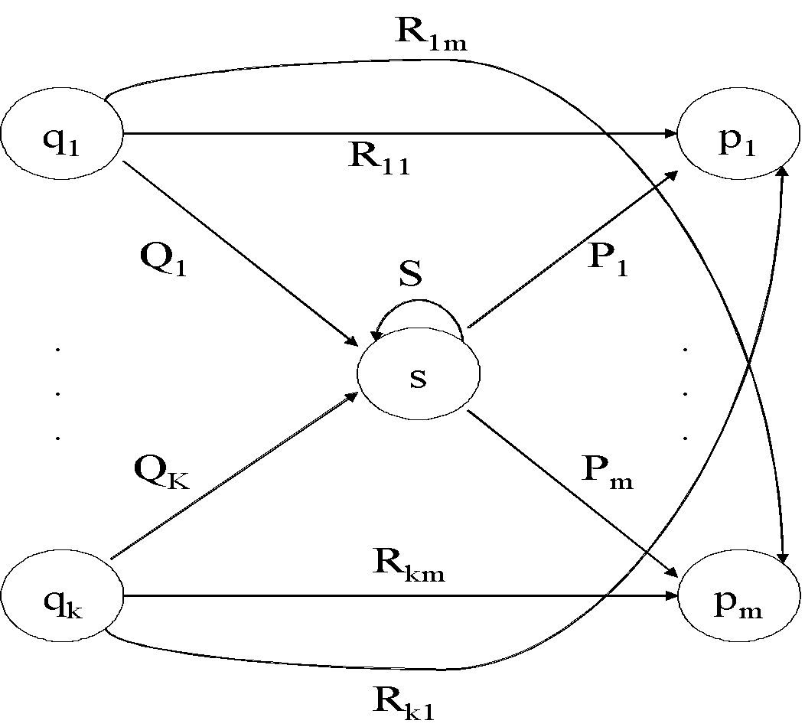
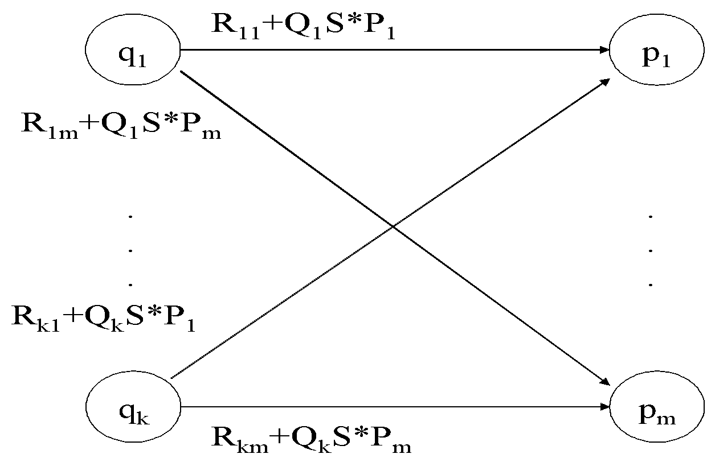
State Elimination
Consider the figure below, which shows a generic state s about to be eliminated. The labels on all edges are regular expressions.
To remove s, we must make labels from each q_{i} to p₁ up to p_{m} that include the paths we could have made through s.
Note: q and p may be the same state!

Slide 88
DFA to RE via State Elimination (1)
Starting with intermediate states and then moving to accepting states, apply the state elimination process to produce an equivalent automaton with regular expression labels on the edges.
The result will be a one or two state automaton with a start state and accepting state.

Slide 89
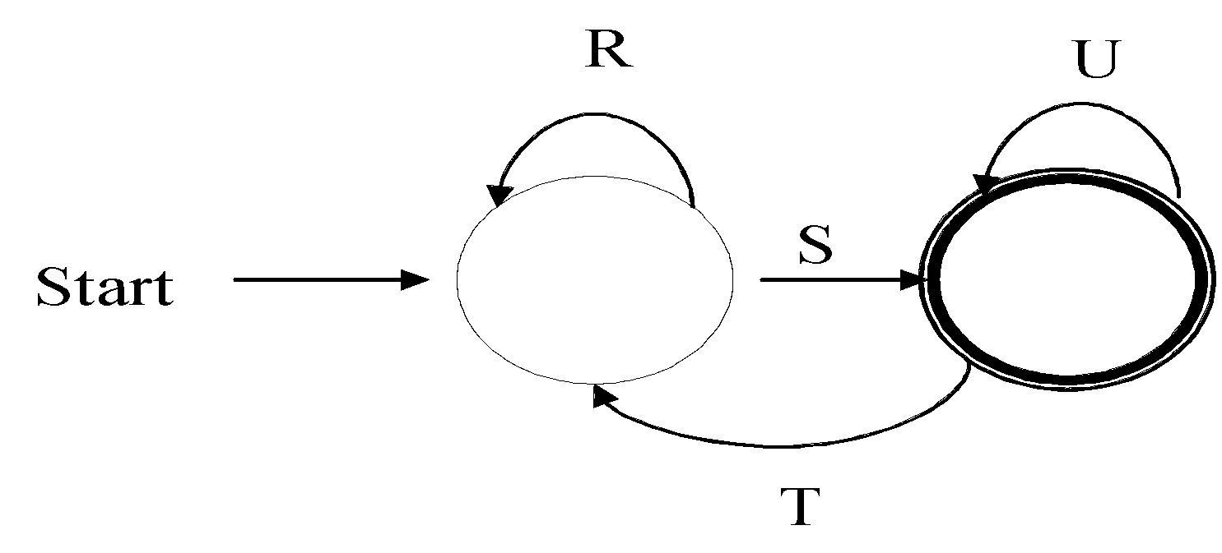
DFA to RE State Elimination (2)
If the two states are different, we will have an automaton that looks like the following:
We can describe this automaton as: (R+SU*T)*SU*

Slide 90
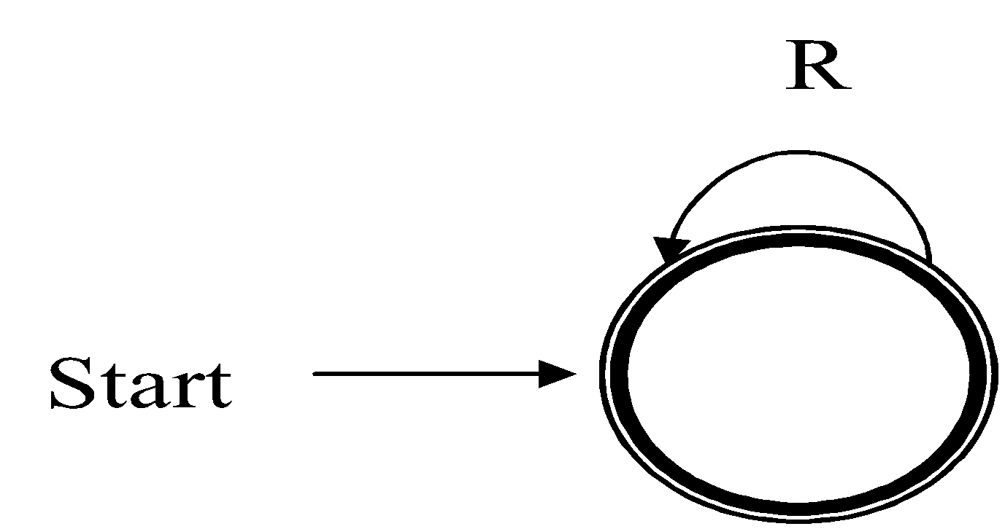
DFA to RE State Elimination (3)
If the start state is also an accepting state, then we must also perform a state elimination from the original automaton that gets rid of every state but the start state. This leaves the following:
We can describe this automaton as simply R*.

Slide 91
DFA to RE State Elimination (4)
If there are n accepting states, we must repeat the above steps for each accepting states to get n different regular expressions, R₁, R₂, … R_{n}. For each repeat we turn any other accepting state to non-accepting. The desired regular expression for the automaton is then the union of each of the n regular expressions: R₁∪ R₂… ∪ R_{N}

Slide 92
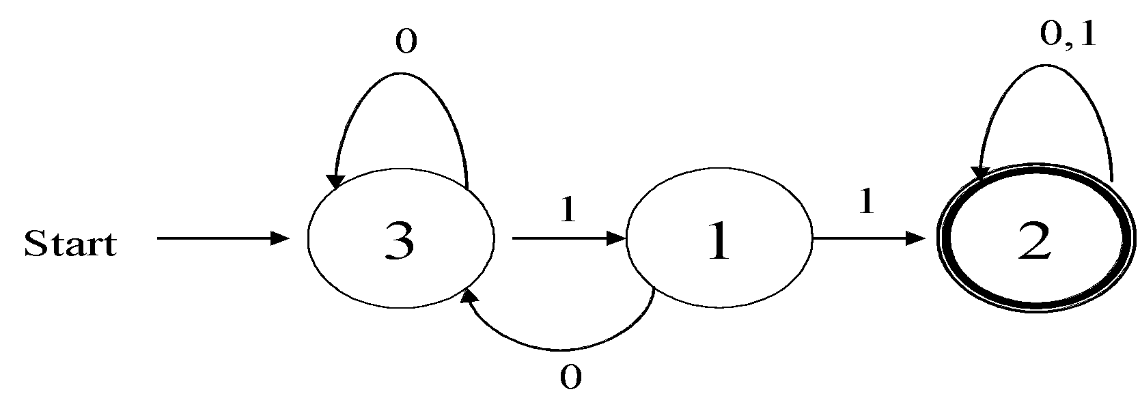
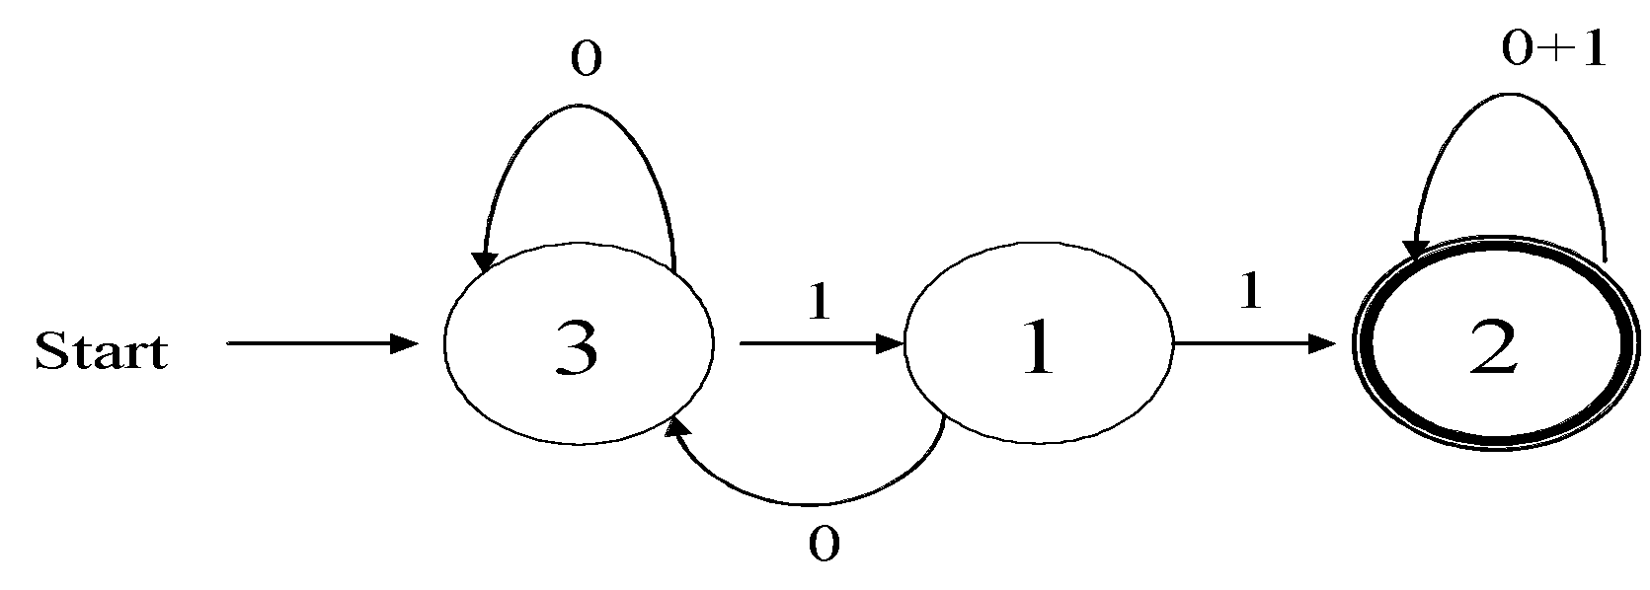
DFA🡪RE Example
Convert the following to a RE
First convert the edges to RE’s:

Slide 93
DFA 🡪 RE Example (2)
0
0+1
Eliminate State 1:
To:
3
1
1
1
2
Start
0
0+10
0+1
Note edge from 3🡪3
3
11
2
Start
Answer: (0+10)*11(0+1)*

Slide 94
Second Example
Automata that accepts even number of 1’s
Eliminate state 2:
0
0
0
1
1
2
1
3
Start
1
0
0+10*1
1
10*1
3
Start

Slide 95
Second Example (2)
0
0+10*1
1
10*1
3
Start
Two accepting states, turn off state 3 first
0
0+10*1
1
10*1
3
Start
This is just 0*; can ignore going to state 3 since we would “die”

Slide 96
Second Example (3)
0
0+10*1
1
10*1
3
Start
Turn off state 1 second:
0
0+10*1
1
10*1
3
This is just 0*10*1(0+10*1)*
Combine from previous slide to get 0* + 0*10*1(0+10*1)*
Start

Slide 97
RE to ε-NFA construction
Reg Ex
ε -NFA
Theorem 1
Suppose ε-NFA₁ and ε-NFA₂ are the automata for R₁ and R₂
Three operations to worry about: union R₁ + R₂, concatenation R₁R2), closure R₁*
With ε-transitions, construction is straightforward
Union: create a new start state, with ε-transitions into the start states of ε-NFA₁ and ε-NFA₂; create a new final state, with ε-transitions from the two final states of ε-NFA₁ and ε-NFA₂
Concatenation: ε-transition from final state of ε-NFA₁ to the start state of ε-NFA₂
Closure: closure can be supported by an ε-transition from final to start state; need a few more ε-transitions (why?)

Slide 98
S
ε
ε
R=S+T
ε
T
ε
S
ε
T
R=ST
ε
ε
S
ε
R=S*
ε

Slide 99
RE to ε-NFA Example
Convert R= (ab+a)* to an NFA
We proceed in stages, starting from simple elements and working our way up
a
a
b
b
a
ε
b
ab

Slide 100
RE to ε-NFA Example (2)
ab+a
a
ε
b
ε
ε
ε
a
ε
ε
(ab+a)*
a
ε
b
ε
ε
ε
ε
ε
a
ε
ε

Slide 101
RE to ε-NFA construction
Reg Ex
ε -NFA
Theorem 1
Example:
(0+1)*01(0+1)*
(0+1)*
01
(0+1)*
ε
ε
ε
0
ε
ε
0
ε
ε
0
1
ε
1
ε
ε
1
ε
ε
ε

Slide 102
Algebraic Laws of Regular Expressions
Commutative:
E+F = F+E
Associative:
(E+F)+G = E+(F+G)
(EF)G = E(FG)
Identity:
E+Φ = E
ε E = E ε = E
Annihilator:
ΦE = EΦ = Φ

Slide 103
Algebraic Laws…
Distributive:
E(F+G) = EF + EG
(F+G)E = FE+GE
Idempotent: E + E = E
Involving Kleene closures:
(E*)* = E*
Φ* = ε
ε* = ε
E⁺ =EE*
E? = ε +E

Slide 104
True or False?
Let R and S be two regular expressions. Then:
((R*)*)* = R* ?
(R+S)* = R* + S* ?
(RS + R)* RS = (RR*S)* ?

Slide 105
Summary
DFA –Definition, Transition diagrams & tables
Regular language
NFA- Definition, Transition diagrams & tables
DFA vs. NFA
NFA to DFA conversion using subset construction
Equivalency of DFA & NFA
Removal of redundant states and including dead states
ε-transitions in NFA
Text searching applications
Simplification of DFAs
How to remove unreachable states?
How to identify and collapse equivalent states?
How to minimize a DFA?
How to tell whether two DFAs are equivalent?

Slide 106
Summary
Regular expressions
Equivalence to finite automata
DFA to regular expression conversion
Regular expression to ε-NFA conversion
Algebraic laws of regular expressions
Unix regular expressions and Lexical Analyzer

